Slide 1
Mobile Robot
Path Drift Estimation using Visual Streams
Helio Perroni Filho
Notes:
Hello everyone, I'm Helio Perroni Filho and this is my presentation on Path Drift Estimation for Mobile Robots using Visual Streams.

Slide 2
Teach-Replay for Robot Navigation
Teaching a robot to move along a route by example
Simpler than programming, can be done by untrained operator
Guide
Teach step
(Robot is guided over path)
1.
Robot
Start
Finish
2.
Replay step
(Autonomous motion)
Robot
Notes:
Currently there is great interest in more intuitive man-machine interfaces for robotics systems, especially robots that can be configured by example, rather than direct programming. The appeal is that robots can then be configured by unskilled operators.
In the context of route planning, this is called teach-replay. For example, let's say we have an office courier robot to carry documents or supplies from one room to another.
If our robot can do teach-replay, first we guide it through the route (what we call the “teach step”),and later, using information gathered along the route, the robot will retrace it autonomously (the “replay step”).

Slide 3
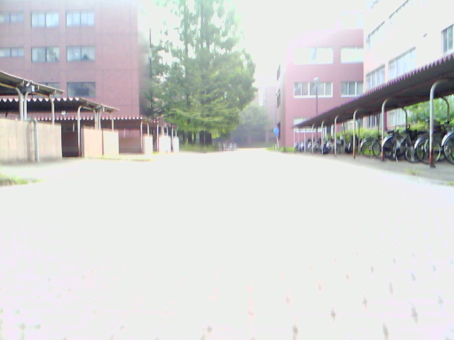
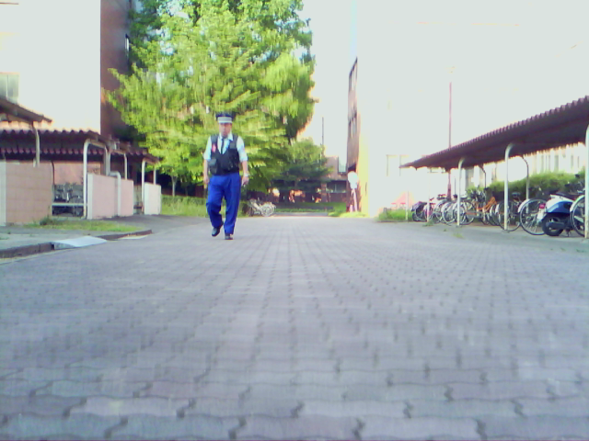
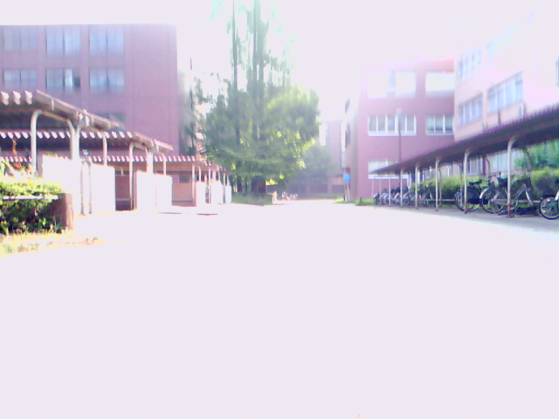
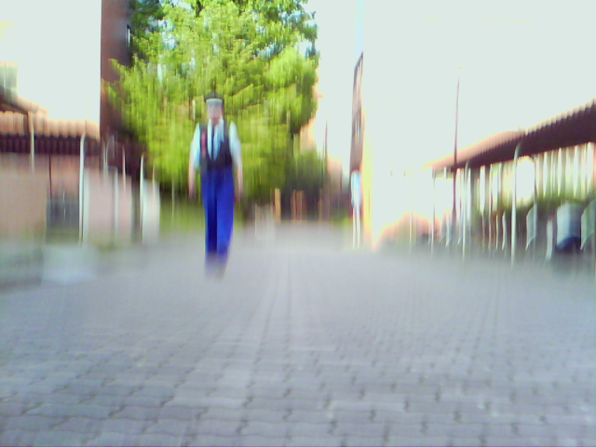
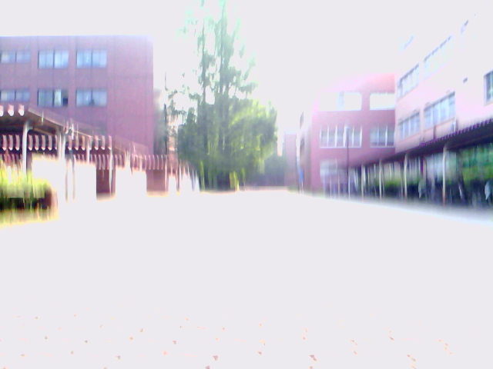
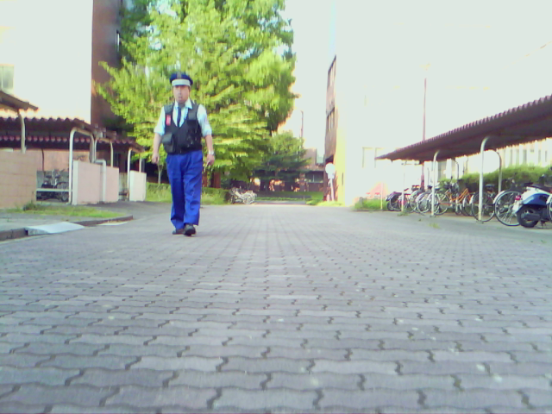
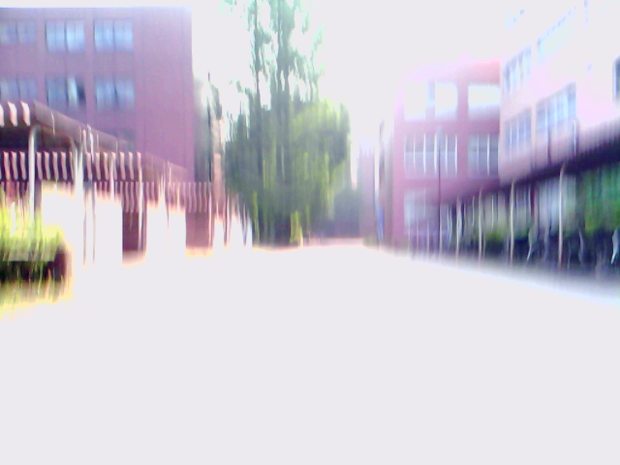
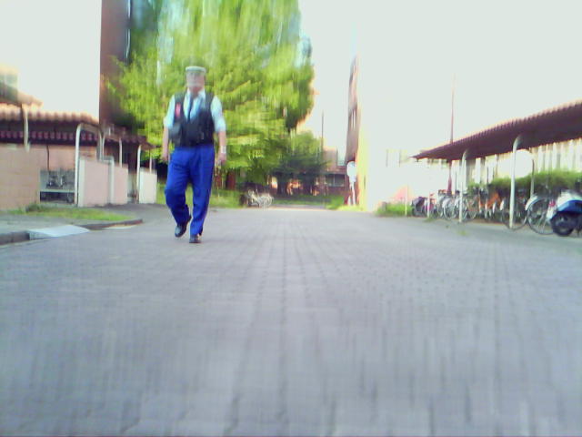
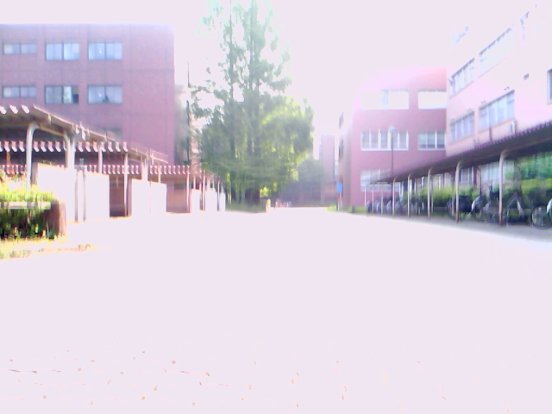
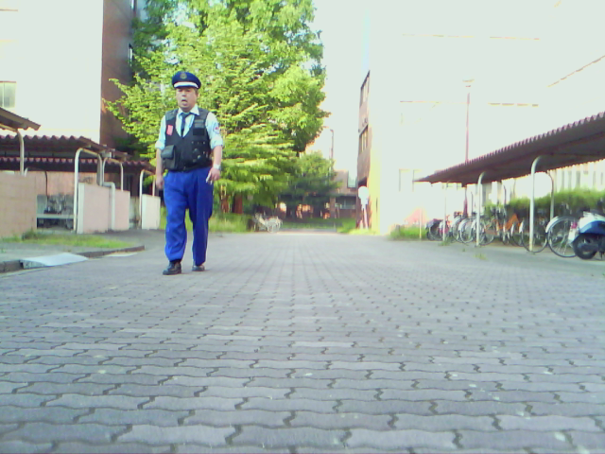
Teach-Replay for Robot Navigation
How to recognize the same landscape across changes in lighting, occlusions, moving elements, etc?
Teach step
Replay step
Need to find and/or compute invariants
Notes:
A lot of work has been done on teach-replay, especially using cameras as sensors. Cameras have many advantages over other kinds of sensors: they are compact, accurate, non-invasive, cheap and ubiquitous.
But extracting physical location from images can be tricky. As can be seen here, lighting changes, occlusion, and the presence of moving elements such as pedestrians can completely change how a landscape looks. It is therefore necessary to find or compute invariants, features that a common to images of a given landscape, despite whatever variations the actual images are subject to.

Slide 4
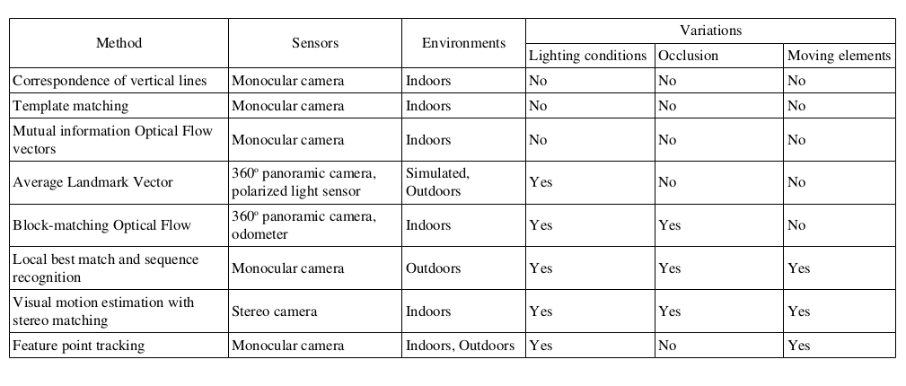
Teach-Replay for Robot Navigation
Many proposed solutions, but all with their limitations
Notes:
Finding invariants that always apply can be tricky, though. As can be seen on this table, many methods have been proposed over the years: most of them deal with computing a representation that is consistent across image variations, such as vertical lines, Optical Flow vectors, Average Landmark Vectors and so on.
However, most of them fall short one way or another. A common limitation is for a method to only work indoors or outdoors. Difficulties on dealing with moving elements, such as people, or occlusions are also common. Some methods also require non-standard hardware, such as stereo cameras.
Therefore, there is still demand for a teach-replay method that works well indoors and outdoors, uses simple hardware such as a single monocular camera, and can deal with changes in lighting and the presence of occlusion and moving objects.

Slide 5
Teach-Replay for Robot Navigation
Differential Visual Streams (DiVS)
  New image processing method
  Stable representations from image sequences
  Requires single, uncalibrated monocular camera
  Robust to lighting changes, occlusion, moving objects
  Applicable indoors and outdoors
  Fast processing, convenient for real-time use
  Basis to implement teach-replay on visual input
Notes:
The limitations of current visual teach-replay methods have motivated me to look for a new solution, which I call Differential Visual Streams, or “DiVS” for short.
It works on image sequences, generating stable representations that are robust to changes in lighting, occlusions and the presence of moving elements. It is applicable to indoors and outdoors environments, requiring a single, uncalibrated monocular camera as input. Last but not least, it is fast to compute, being convenient for real-time operation.
Therefore, DiVS provides a sound base for the implementation of teach-replay on visual input.

Slide 6
Topics
Teach-Replay for Robot Navigation
Differential Visual Streams (DiVS)
Control Model
Experiments
Conclusions
Further Research
Notes:
The DiVS method and its application to teach-replay are the subjects of the remainder of this presentation.
In the next section I describe the DiVS method. Then I show how it can be used to implement a teach-replay control module for a mobile robot.
Next I show the results of a number of experiments made with the control module, what conclusions can be drawn from those results, and discuss directions for further research.

Slide 7
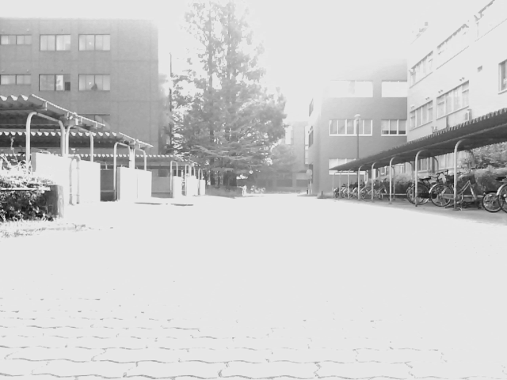
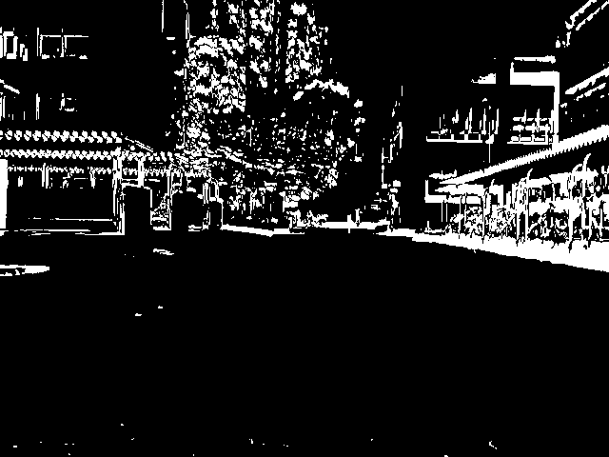
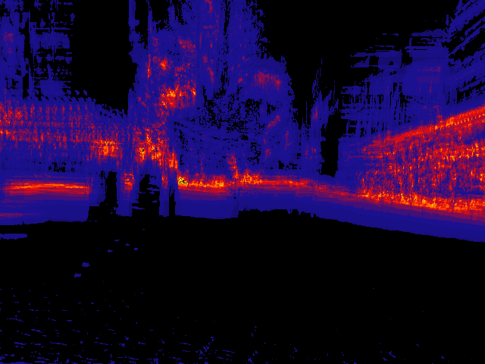
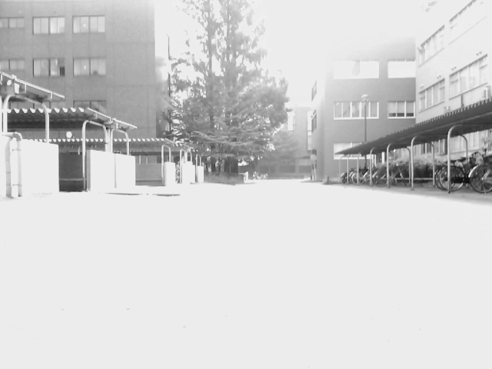
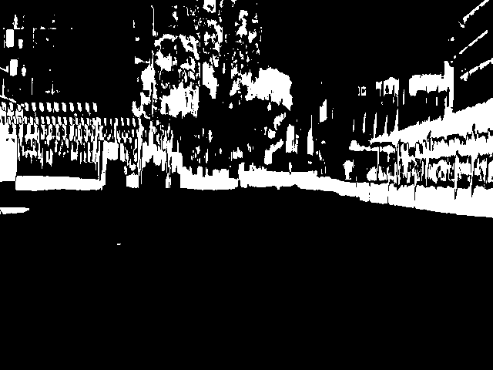
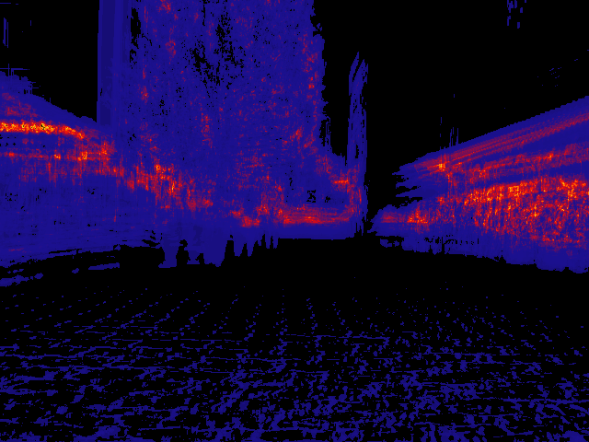
Differential Visual Streams (DiVS)
Converts an image sequence into differential images robust to lighting changes, occlusion and moving elements
Grayscale images
Thresholded difference images
(lighting invariant)
Averaged images
(movement / occlusion invariant)
…
…
…
I1, ..., Iw, ..., It
Bk = OTSU(|Ik-1 - Ik|)
Notes:
Given a sequence of gray-scale images, the changes between successive images can be represented by the pixel-by-pixel absolute difference between them. The darker regions of such difference images show where the two images are very similar to each other, and the brighter regions, where they are different. This separation between “change” and “no change” regions can be enhanced by the application of a thresholding operation, such as Otsu's method.
These thresholded difference images provide representations stable to lighting changes, but they are still affected by occlusions and moving elements. In order to account for that, we smooth out such transient changes by calculating the average over a sequence of difference images.
These are what I call differential images, they show the amount of change in different regions of the visual field over a sequence window of some size w. Brighter colors show high amounts of change, and darker colors, low amounts.

Slide 8
Topics
Teach-Replay for Robot Navigation
Differential Visual Streams (DiVS)
Control Model
Experiments
Conclusions
Further Research
Notes:
So DiVS provides a representation that is robust to changes in lighting, occlusion and moving elements. How can it be leveraged to implement teach-replay navigation?

Slide 9
Control Model
Image shift is converted to a control signal to correct drift
Front View
(camera image)
Top View
Landmark
Teach
Robot
Replay
drift
Δy < 0
Δθ < 0
shift
(pixels)
p < 0
Notes:
First we need to know how changes in observer location are related to visual input.
Given a robot in a very simple environment with a single landmark, if they are perfectly aligned...
The landmark's image will fall on the center of the robot's visual field. Whereas if the robot is drifting to the right...
The landmark's image will fall on the left side of its visual field.
This relation between physical drift and image shift can be explored to enable robot localization.
Empirical tests suggest a linear relation to image shifts and drifts in distance from the original path and heading direction. Therefore, in our control model we convert image shifts, which are given in pixels, to drift estimates merely by applying a cut-off limit, followed by an optional scaling factor.

Slide 10
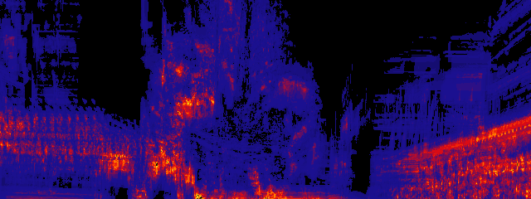
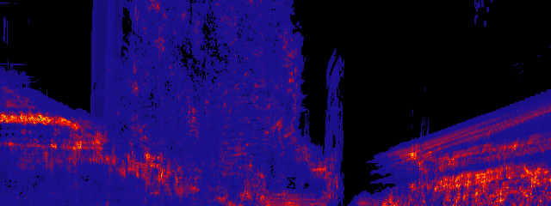
Control Model
Differential images can be compared for shift
image center
teach
teach
match guides
shift p < 0
replay
image center
replay
Remove bottom half
(poor signal / noise)
Match images by discontinuities
Notes:
DiVS images can be compared for shift. In this example we compare a DiVS image from a teach step to another from a replay step.
First, notice that the bottom half of DiVS images is usually of poor recognition value. Because it mostly pictures the ground, it is either largely empty, or filled with noisy patterns such as those left by floor tiles. Therefore, before trying to compare DiVS images, we do away with their lower halves, keeping only the upper halves for comparison.
Then we look for the best match between the teach and replay half-images, using sharp discontinuities in the images as a guide. The position of best match indicates the shift between teach and replay DiVS images. As shown before, shifts are measured in pixels, can be either negative or positive. Negative shifts indicate drifts o the right, and positive shifts, drifts to the left.
Incidentally in this example the shift is negative, indicating a drift to the right.

Slide 11
Control Model
Shifts over time indicate the robot's route relative to a reference
Teach
∂w
∂
...
∂
...
∂t
w+1
t-w
shift calculation
teach
Replay
∂'w
∂'
...
∂'
...
∂'t
w+1
t-w
replay
Notes:
Given two DiVS image sequences, say from a teach path and a replay path, shifts can be computed for successive image pairs. Plotting these shifts over time, we produce an approximation of the robot's deviation from the teach path as it moves along the replay path.

Slide 12
Topics
Teach-Replay for Robot Navigation
Appearance-based Navigation
Differential Visual Streams (DiVS)
Control Model
Experiments
Conclusions
Further Research
Notes:
How well does the method described so far work?

Slide 13
Experiments
Teach / Teach tests
  Compare two teach step records
  Check quality of computed image shifts
  Off-line
Reference record
Test records
5°
0°
-5°
Early morning 07/24 07:30~
No moving elements
Late afternoon 07/30 16:15~
Occasional moving elements
(pedestrians, cyclists)
Notes:
First, in order to check if image shift values were consistent across different amounts of drift and visual conditions, several teach steps were recorded and compared off-line.
The reference teach step was recorded in the morning, in the absence of any moving elements. The test records were recorded in the afternoon, and occasionally contain moving elements such as pedestrians or cyclists.
Two of the test records differed from the reference by an initial in-place turn of 5°, either to the left or to the right.

Slide 14
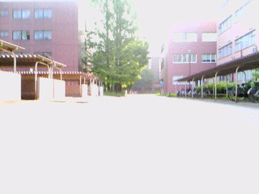
Experiments
Teach / Teach tests
Reference record
Notes:
The reference record is as shown here. As you can see there is a lot of vibration due to the uneven floor, as well as large saturated regions due to poor camera hardware.

Slide 15
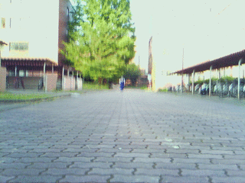
Experiments
Teach / Teach tests
Test record 0°
Notes:
The first test record includes a moving element: a campus officer walks towards the robot, eventually passing it by.

Slide 16
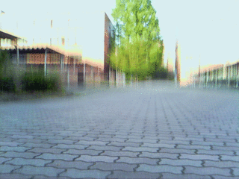
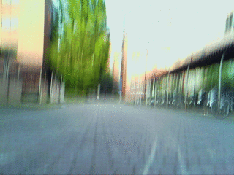
Experiments
Teach / Teach tests
Test record 5°
Test record -5°
Notes:
For initial in-place turns of 5° left and right, no moving elements in sight.

Slide 17
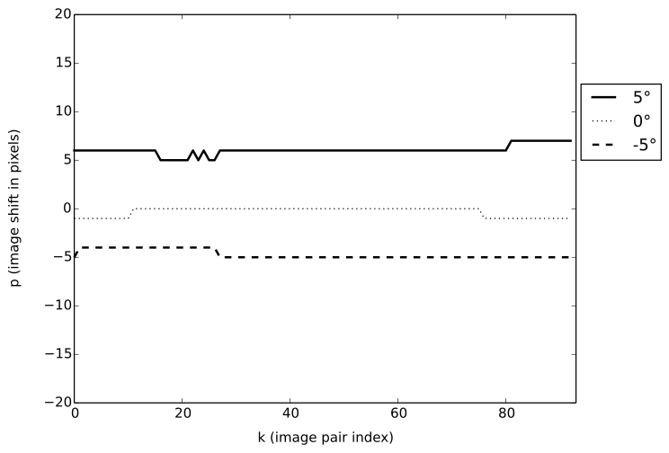
Experiments
Good results: right direction, consistent values
Notes:
Despite the differences in visual conditions and the presence of a moving element for much of the test record, the computed shifts for the 0° case either zero or negligible, correctly indicating the robot is treading much the same path as in the reference record.
Results were very good for the 5° drift cases too: shift direction agrees with drift's, and numerical values are consistent.

Slide 18
Experiments
Teach / Replay tests
  Drive the robot using a teach step record
  Check quality of estimated drifts
  On-line
Teach step
Replay steps
5°
2°
-2°
-5°
Early morning 07/24 07:30~
No moving elements
Early morning 07/24 07:30~
Occasional moving elements
(pedestrians, cyclists)
Notes:
So shift calculations are go, how well do they translate to robot steering?
To test the control module, the robot was set-off at straight paths diverging from the original teach path by an initial in-lace turn of 2° or 5°, either left or right.
The robot records images as it goes, and as soon as it has enough to calculate a DiVS image, it computes shift between it and the corresponding teach DiVS image, steering in response to any non-zero shifts found.

Slide 19
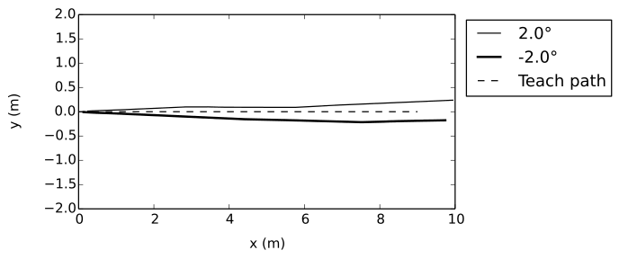
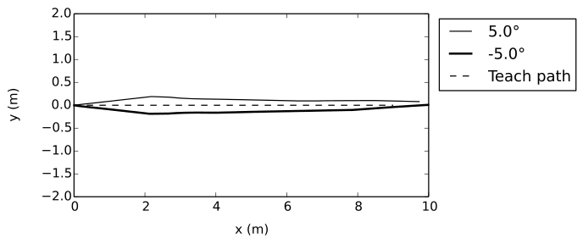
Experiments
Poor results: divergence / slow convergence to teach path
Good results: steady convergence to teach path
Notes:
These plots compare the teach step path with two replay paths, starting from initial in-place turns of 2° or 5°, either left and right.
The dashed line shows the teach path, which is a simple straight path. The solid line and the bold solid line represent the replay paths from left drift and right drift respectively.
Teach / replay results were mixed. For 2° drift, in the left case, after an initial route correction in the right direction, the robot settles in a path parallel to the teach step's, but eventually deviates from it. For the right drift case, it takes a long time to recognize the drift; it does start converging towards the teach path then, but too slowly.
For 5° drifts, results were much better, with the robot eventually returning to the teach path.
The main reason for these sub-optimal results is because differences in sideways position produce much less disparity in far-off landmarks, which compose the bulk of the landscape in many environments, especially outdoors. This results in much more subtle differences between DiVS images, and smaller, less definite shifts. So after an initial route correction, if the robot happens to arrive at a path parallel to the teach step's, it becomes much harder to produce further route corrections from there.

Slide 20
Topics
Teach-Replay for Robot Navigation
Differential Visual Streams (DiVS)
Control Model
Experiments
Conclusions
Further Research
Notes:
What conclusions do I get from these experiments, and where to go from here?

Slide 21
Conclusions
DiVS provides a visual representation robust to:
  Lighting changes
  Occlusion
  Moving Elements
DiVS image shift correlates well with route drift
  Direction of shift indicates direction of drift
  Shift amount correlates (linearly?) with drift distance
  Teach-replay navigation over DiVS is possible
Main weakness is sideways drift

Slide 22
Further Research
Sideways drift detection
Small turning drift detection
Further field tests
More elaborate paths
Control model

Slide 23
The End
Questions?
Notes:
This is the end of my presentation. Any questions?

Slide 24
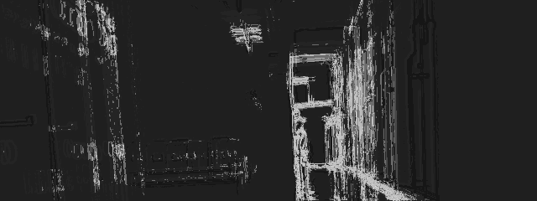
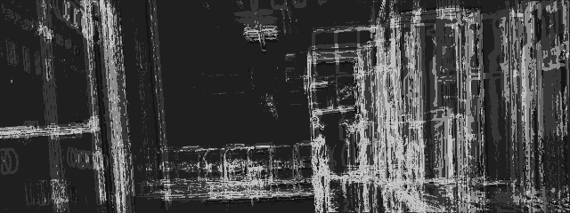
Curved path

Slide 25
Sideways drift
Problem: poor shift results when robot moves
parallel to teach path
Notes:
The main reason for these sub-optimal results is because differences in sideways position produce much less disparity in far-off landmarks, which compose the bulk of the landscape in many environments, especially outdoors. This results in much more subtle differences between DiVS images, and smaller, less definite shifts. So after an initial rout correction, if the robot happens to arrive at a path parallel to the teach step's, it becomes much harder to produce further route corrections from there.

Slide 26
DiVS buffering lag
I =
I0
I1
I2
...
Iw-1
Iw
Iw+1
...
It-w
...
It
B =
B1
B2
...
B
Bw
B
...
B
...
Bt
w-1
w+1
t-w
DiVS =
∂w
∂
...
∂
...
∂t
w+1
t-w
Notes:
Let's do a quick recap on the process so far:
Starting from an image sequence, or stream...
We calculate pair-wise, thresholded difference images...
And then average those binary images over a window of some size w.
The sequence of images calculated according to this procedure is what I call a Differential Visual Stream, or DiVS.

